Slide 1

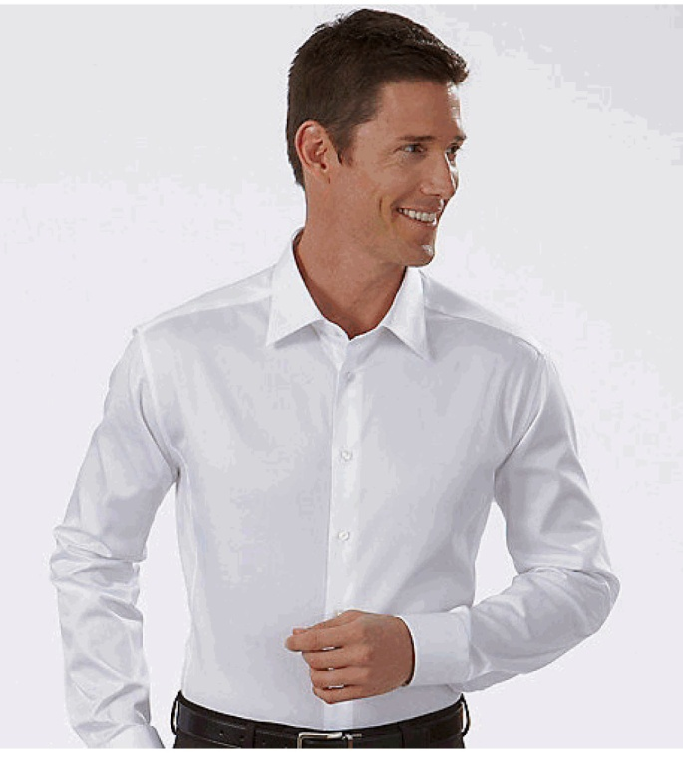
AD1010
Description: Male LS Dress Shirt, White
Fabric Content: 98% Cotton, 2% Spandex
Features: Contoured for a comfortable fit, tapered at waist.
French placket
Spread collar
Double button barrel cuff

Slide 2
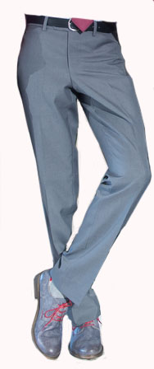
AD4015
Description: Male Flat Front Pant, Grey
Fabric Content: 75% Polyester, 25% Wool Serge
Features: Waistband with metal hook & eye and button/buttonhole closure.
Western style front pockets
Single welt back hip pockets with button thru closure

Slide 3
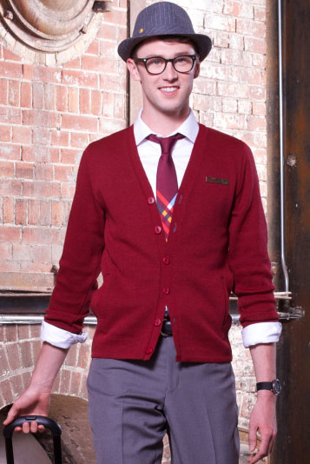
AD5011
Description: Male Cardigan, Burgundy
Fabric Content: 100% Durapil Acrylic Knit
Features: Slim fit
V-neck
Button front
Contrast sewn buttonholes
Single welt slash pockets

Slide 4
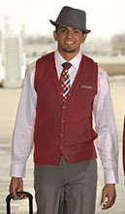
AD5012
Description: Male Vest, Burgundy
Fabric Content: 100% Durapil Acrylic Knit
Features: Slim fit
V-neck
Button front
Contrast sewn buttonholes
Single welt slash pockets

Slide 5
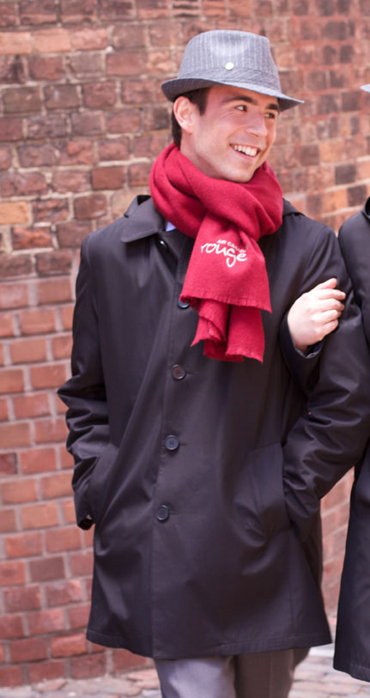
AD3010
Description: Male All Weather Coat, Black
Fabric Content: Shell, 100% Polyester
Liner, Quilted Polyester Thinsulate
Features: Slim fit
Fully lined
Button front
Single welt slash pockets
Zip out Liner
Detachable hood with drawstring
Rouge Embroidered Logo on Left Upper Chest

Slide 6
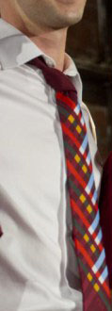
AD7032
Description: AC Rouge 4-in-Hand Tie
Fabric Content: 100% Printed Polyester
Colour: Burgundy ground print

Slide 7
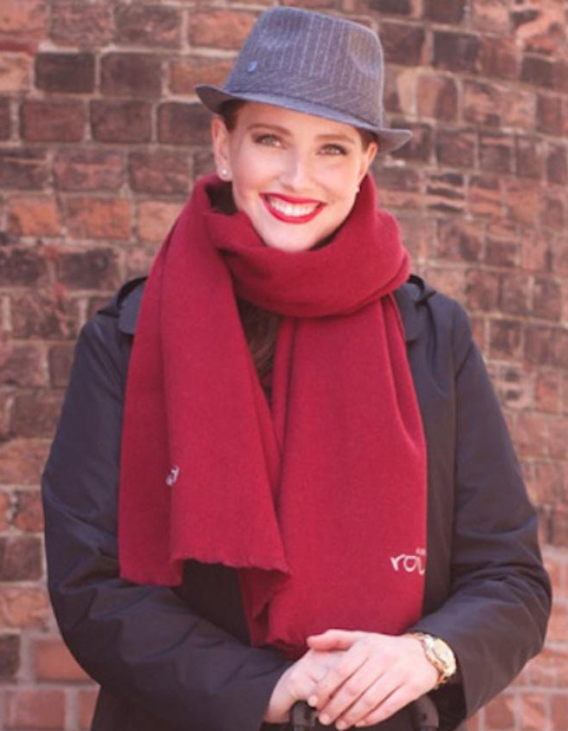
AD7038
Description: AC Rouge Winter Scarf, Burgundy
Fabric Content: 100% Wool
Colour: Burgundy
Dimensions: 75” X 19-1/2”
Rouge Embroidered Logo on both ends of scarf

Slide 8
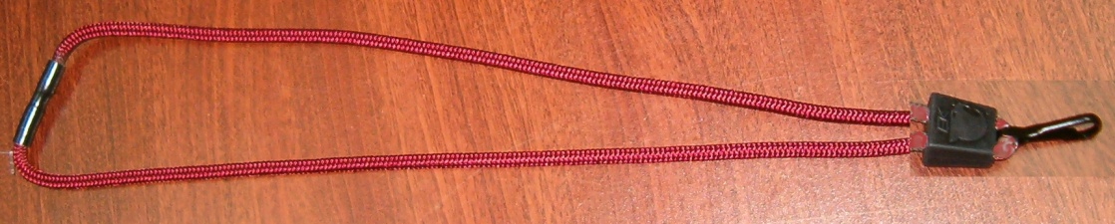
AD7010
Description: Lanyard, Red
Content: 100% Nylon
Feature: Nylon cord with safety breakaway feature
Colour: Red

Slide 9
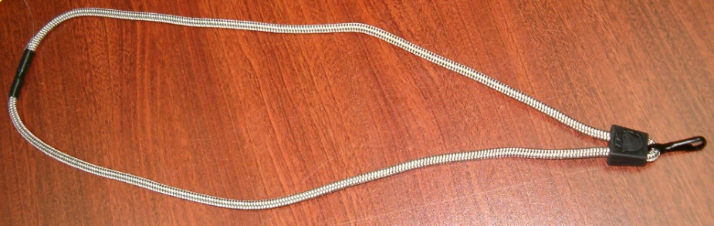
AD7011
Description: Lanyard, Grey
Content: 100% Nylon
Feature: Nylon cord with safety breakaway feature
Colour: Grey

Slide 10
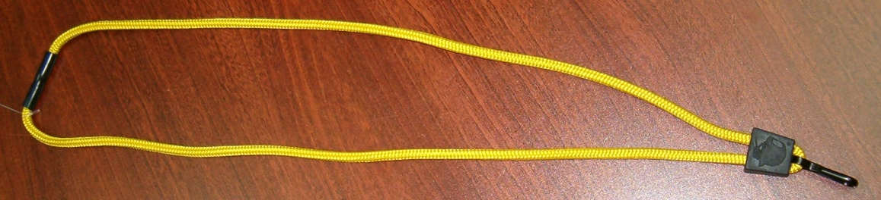
AD7012
Description: Lanyard, Yellow
Content: 100% Nylon
Feature: Nylon cord with safety breakaway feature
Colour: Yellow

Slide 11
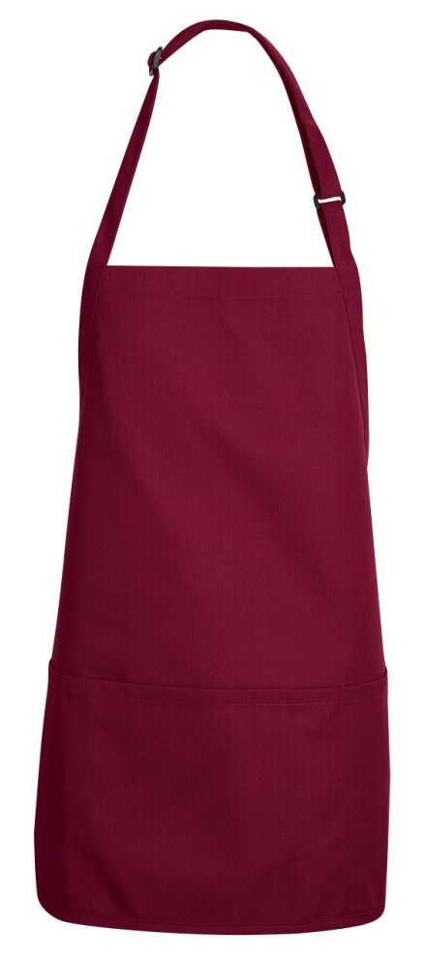
TT32BR
Description: Bib Apron, Burgundy
Fabric Content: 65% Polyester, 35% Cotton Twill
Colour: Burgundy
Features: Adjustable neck strap with plastic buckle
Three section pocket
Dimension: 28” X 24”
Rouge Embroidered Logo on Center Top Front of Apron

Slide 12
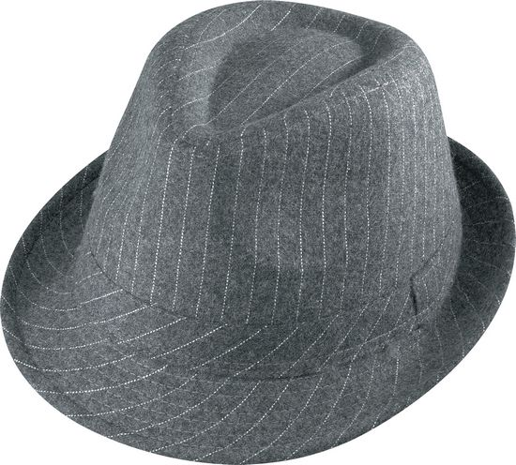
AD7933
Description: AC Rouge Fedora Hat, Grey
Fabric Content: 80% Viscose, 20% Wool
Colour: Grey Pinstripe

Slide 13
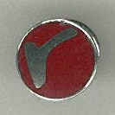


AD7009
Description: AC Rouge Pin
Content: 100% Brass, nickel plated
Colours: Silver/Burgundy
Silver/yellow
Silver/Blue

Slide 14
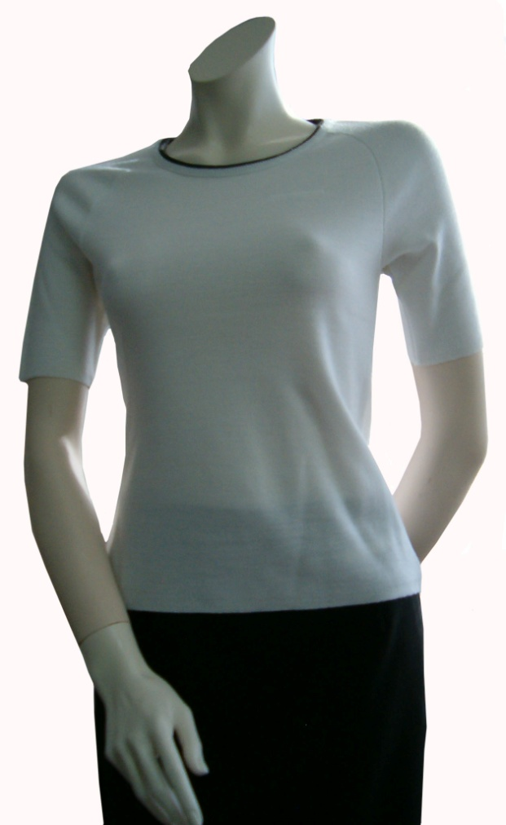
AD5014
Description: SS Shell, White
Fabric Content: 100% Durapil Acrylic Knit
Features: Contrast grey tipping on neckline
Raglan sleeves

Slide 15
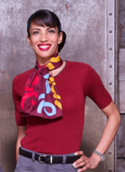
AD5013
Description: SS Shell, Burgundy
Fabric Content: 100% Durapil Acrylic Knit
Features: Contrast grey tipping on neckline
Raglan sleeves

Slide 16
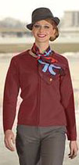
AD5010
Description: Female Zip Front Cardigan, Burgundy
Fabric Content: 100% Durapil Acrylic Knit
Features: Raglan sleeves
Two way zipper front closure

Slide 17
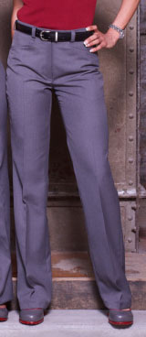
AD4025
Description: Female Flat Front Pant, Grey
Fabric Content: 75% Polyester, 25% Wool Serge
Features: Waistband with metal hook & eye and button/buttonhole closure.
Western style front pockets

Slide 18
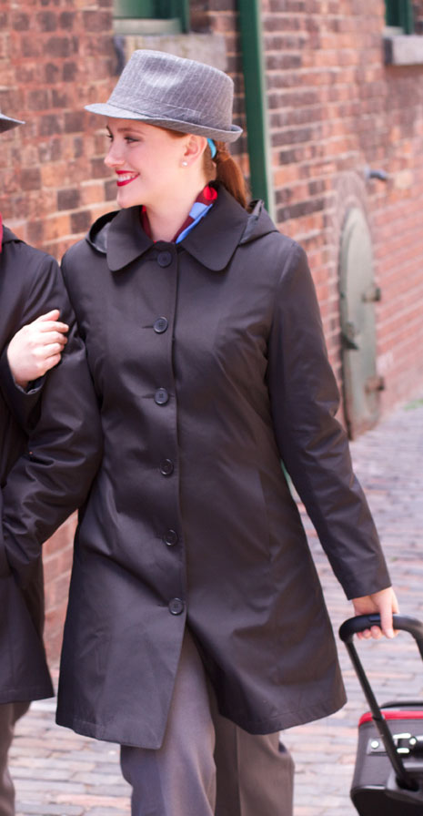
AD3020
Description: Female All Weather Coat, Black
Fabric Content: Shell, 100% Polyester
Liner, Quilted Polyester Thinsulate
Features: Slim fit
Fully lined
Button front
Single welt slash pockets
Zip out Liner
Detachable hood with drawstring
Rouge Embroidered Logo on Left Upper Chest

Slide 19

AD7034
Description: AC Rouge Dress Scarf, Burgundy
Fabric Content: 100% Printed Polyester
Colour: Burgundy ground print
Dimensions: 11-1/2” X 43”

Slide 20
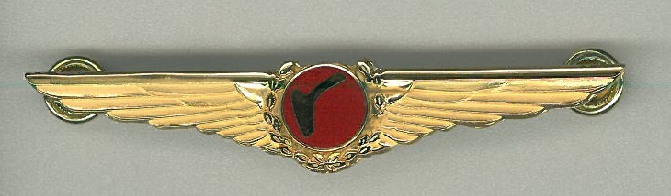
AD7027
Description: AC Rouge Captain Screw-back Wing
AD7028
Description: AC Rouge Captain Clutch-back Wing
Content: 100% Brass, gold plated
Colour: Gold

Slide 21
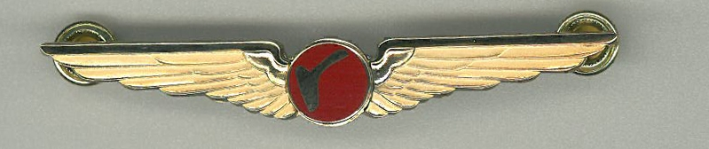
AD7029
Description: AC Rouge First Officer Screw-back Wing
AD7030
Description: AC Rouge First Officer Clutch-back Wing
Content: 100% Brass, gold plated
Colour: Gold

Slide 22
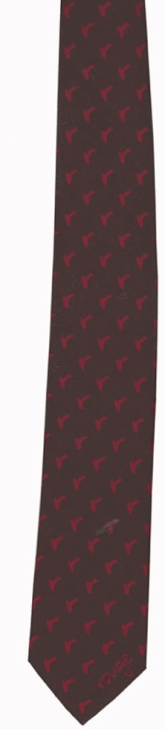
AD7005
Description: AC Rouge Pilot Tie, Burgundy
AD7006
Description: AC Rouge Pilot Clip-on Tie, Burgundy
Fabric Content: 100% Polyester Jacquard
Colour: Burgundy

